Slide 1
GNU/Linux
Amin Khozaei (@shirazlug)
Telegram: @Amin_Khozaei
Email: amin.khozaei@gmail.com
Date: 2018-11-26
Notes:
Advocacy for Advocates, © 2018 by Nathan Haines.
Available under a Creative Commons 4.0 Attribution (CC-BY) license.
Introduce yourself and Ubuntu.
I want to give some advice for people who are excited about Free Software and want to get others excited as well.

Slide 2

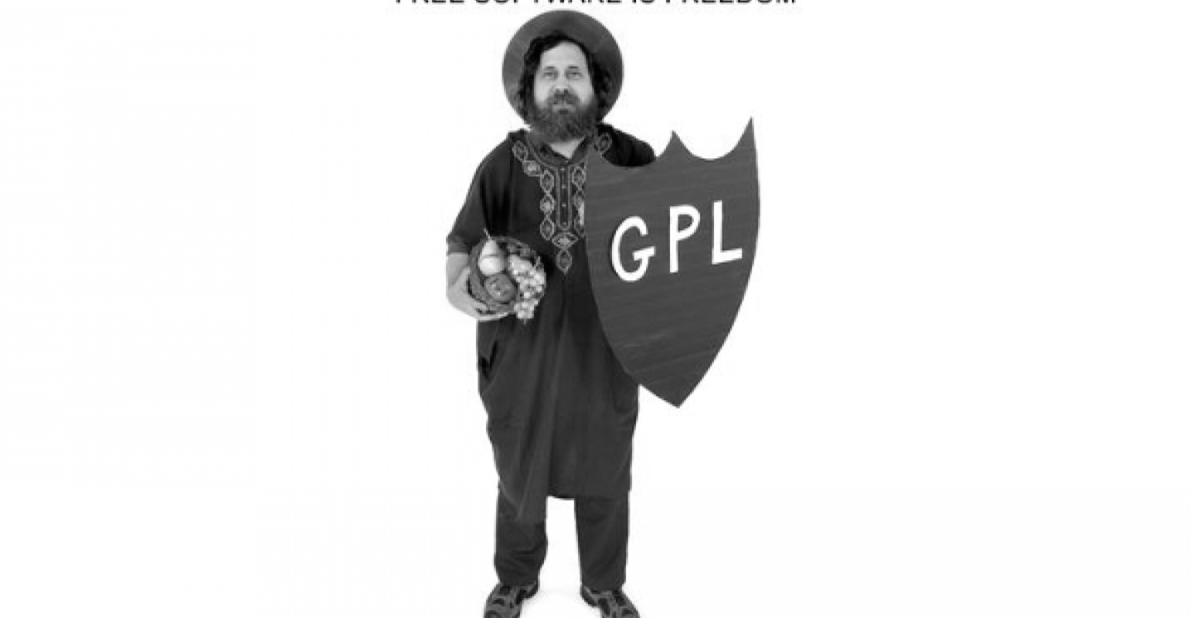
GNU Project
In 1983, Richard Stallman started the GNU project with the goal of creating a free UNIX-like operating system.
Free Software
  The freedom to run the program as you wish, for any purpose (freedom 0).
  The freedom to study how the program works, and adapt it to your needs (freedom 1). Access to the source code is a precondition for this.
  The freedom to redistribute copies so you can help your neighbor (freedom 2).
  The freedom to improve the program, and release your improvements to the public, so that the whole community benefits (freedom 3). Access to the source code is a precondition for this.
Free software puts its users in control of their own computing.
Nonfree software puts its users under the power of the software's developer.
Notes:
I’m an author. You may know me from such books as “Beginning Ubuntu for Windows and Mac Users,” or “Beginning Ubuntu for Windows and Mac Users, Second Edition.”

Slide 3
History of Unix/Linux
Linux was introduced by Linus Torvalds, a student in Finland(1991).
Hello everybody out there using minix -
I'm doing a (free) operating system (just a hobby, won't be big and professional like gnu) for 386(486) AT clones. This has been brewing since april, and is starting to get ready. I'd like any feedback on things people like/dislike in minix, as my OS resembles it somewhat (same physical layout of the file-system (due to practical reasons) among other things).
I've currently ported bash(1.08) and gcc(1.40), and things seem to work. This implies that I'll get something practical within a few months, and I'd like to know what features most people would want. Any suggestions are welcome, but I won't promise I'll implement them :-)
Linus (torvalds@kruuna.helsinki.fi)
PS. Yes - it's free of any minix code, and it has a multi-threaded fs. It is NOT portable (uses 386 task switching etc), and it probably never will support anything other than AT-harddisks, as that's all I have :-(.
— Linus Torvalds
Notes:
I’m an author. You may know me from such books as “Beginning Ubuntu for Windows and Mac Users,” or “Beginning Ubuntu for Windows and Mac Users, Second Edition.”

Slide 4
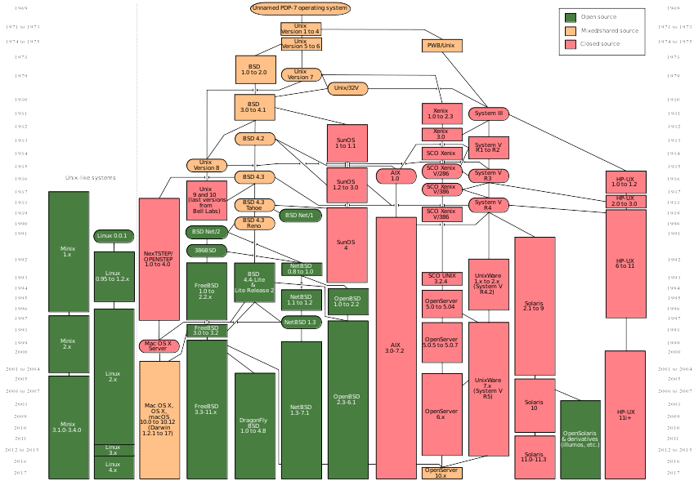
History of Unix/Linux...
Notes:
I’m an author. You may know me from such books as “Beginning Ubuntu for Windows and Mac Users,” or “Beginning Ubuntu for Windows and Mac Users, Second Edition.”

Slide 5
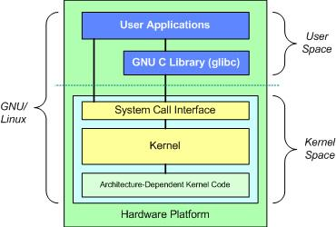
GNU and Linux
Notes:
I’m an author. You may know me from such books as “Beginning Ubuntu for Windows and Mac Users,” or “Beginning Ubuntu for Windows and Mac Users, Second Edition.”

Slide 6
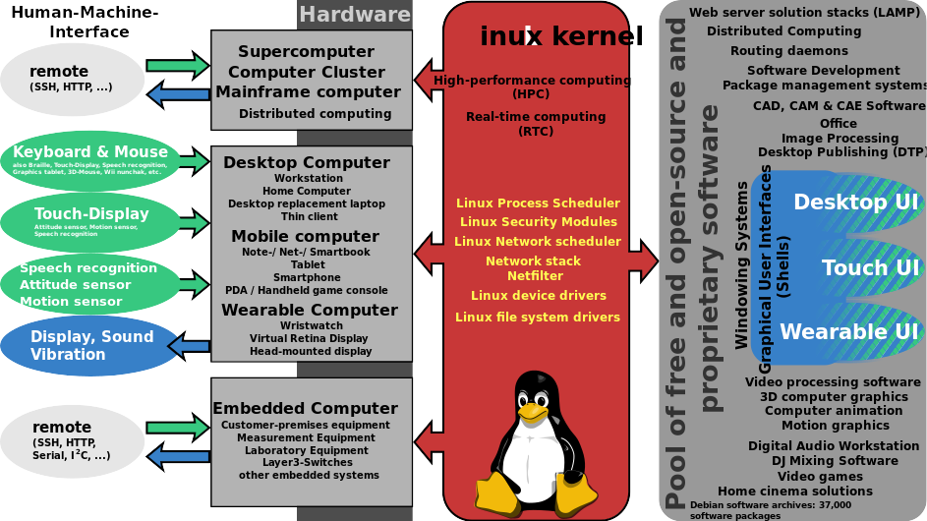
Distributions
Notes:
I’m an author. You may know me from such books as “Beginning Ubuntu for Windows and Mac Users,” or “Beginning Ubuntu for Windows and Mac Users, Second Edition.”

Slide 7
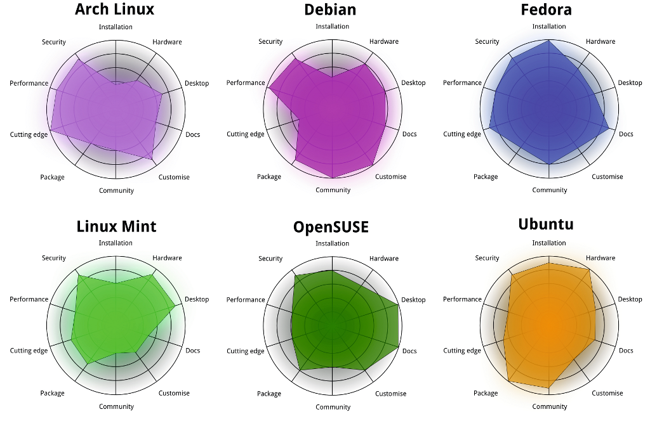
Distributions...
Notes:
I’m an author. You may know me from such books as “Beginning Ubuntu for Windows and Mac Users,” or “Beginning Ubuntu for Windows and Mac Users, Second Edition.”

Slide 8
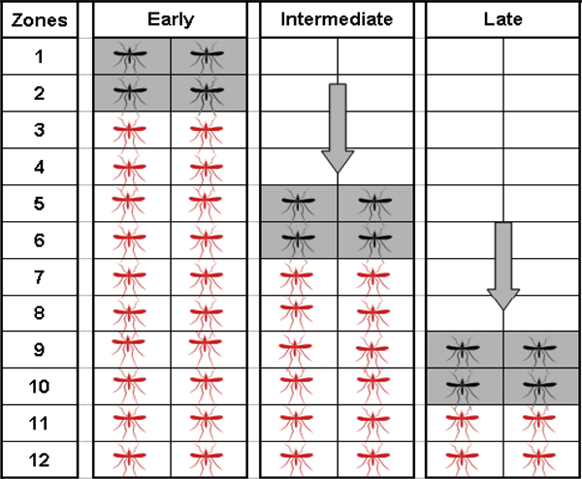
Rolling or Point Release
Full-rolling
  Arch, Gentoo, ...
Part-rolling
  Fedora, Ubuntu, ...
Notes:
I’m an author. You may know me from such books as “Beginning Ubuntu for Windows and Mac Users,” or “Beginning Ubuntu for Windows and Mac Users, Second Edition.”

Slide 9
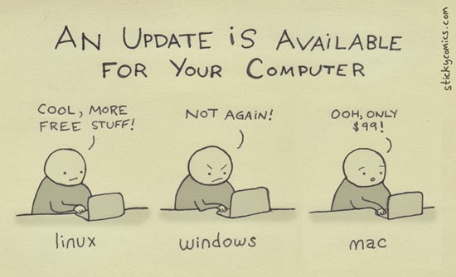
Why GNU/Linux is Better Than Windows/Mac?
Open Source Nature
Secure
Can revive older computers
Perfect For Programmers
Software Updates
Customization
Variety Of Distributions
Free to Use
Better Community Support
Reliability
Privacy
Notes:
I’m an author. You may know me from such books as “Beginning Ubuntu for Windows and Mac Users,” or “Beginning Ubuntu for Windows and Mac Users, Second Edition.”

Slide 10
General Tools
Browsers
  Firefox
  Chromium
Download Managers
  Persepolis
  uGet
  Xtreme Download Manager (XDM)
Notes:
I’m an author. You may know me from such books as “Beginning Ubuntu for Windows and Mac Users,” or “Beginning Ubuntu for Windows and Mac Users, Second Edition.”

Slide 11
General Tools...
Cloud Storage
  Owncloud
  Nextcloud
Office suite
  LibreOffice
  OpenOffice
  Calligra
Notes:
I’m an author. You may know me from such books as “Beginning Ubuntu for Windows and Mac Users,” or “Beginning Ubuntu for Windows and Mac Users, Second Edition.”

Slide 12
General Tools...
Music Player
  Lollypop
  Rhythmbox
Video Player
  VLC
  Totem
  Kodi
Notes:
I’m an author. You may know me from such books as “Beginning Ubuntu for Windows and Mac Users,” or “Beginning Ubuntu for Windows and Mac Users, Second Edition.”

Slide 13
General Tools...
Photo Editor
  GIMP
  Krita
Vector Graphics Editor
  Inkscape
Text Editor
  Vim
  Emacs
  Atom
Notes:
I’m an author. You may know me from such books as “Beginning Ubuntu for Windows and Mac Users,” or “Beginning Ubuntu for Windows and Mac Users, Second Edition.”

Slide 14
Statistical tools
R
KNIME
Octave
Maxima
Python
PSPP
Notes:
I’m an author. You may know me from such books as “Beginning Ubuntu for Windows and Mac Users,” or “Beginning Ubuntu for Windows and Mac Users, Second Edition.”

Slide 15
Installation
dd if=/path/to/iso of=/dev/sdXY conv=sync bs=1M status=progress
Notes:
I’m an author. You may know me from such books as “Beginning Ubuntu for Windows and Mac Users,” or “Beginning Ubuntu for Windows and Mac Users, Second Edition.”

Slide 16



